Slide 1

Notes:
The color directive will be inherited Probably need to learn how to set it globally and override it locally add your name here This is an html style comment html tags are for the most part supported by marp. Add a line like the one below to modify the slide to show your name as a second level header you can simply copy and paste the line to outside the comment block ## My name is xxxx

Slide 2

Notes:
paginate adds slide numbers, we start on the second

Slide 3
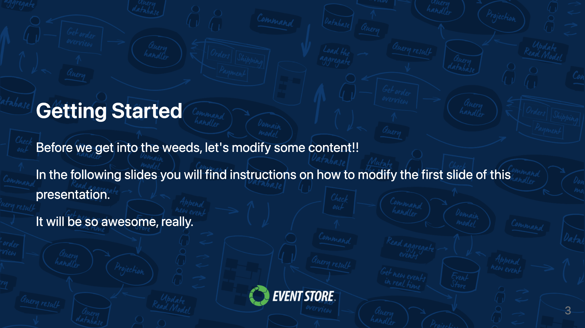

Slide 4
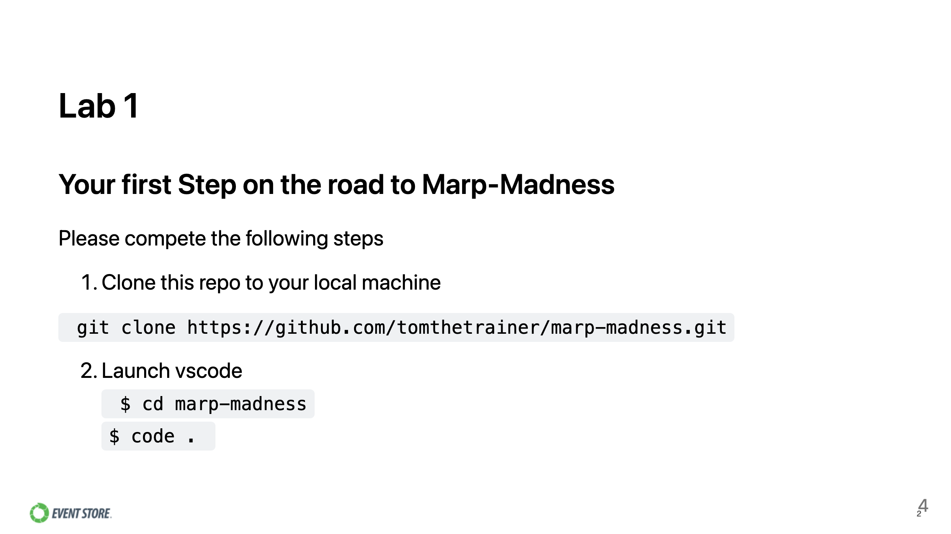
Notes:
Note we change backgrounds here, I think in classes we will have separate lab instructions, but since marp is the lab here, just demonstrating

Slide 5
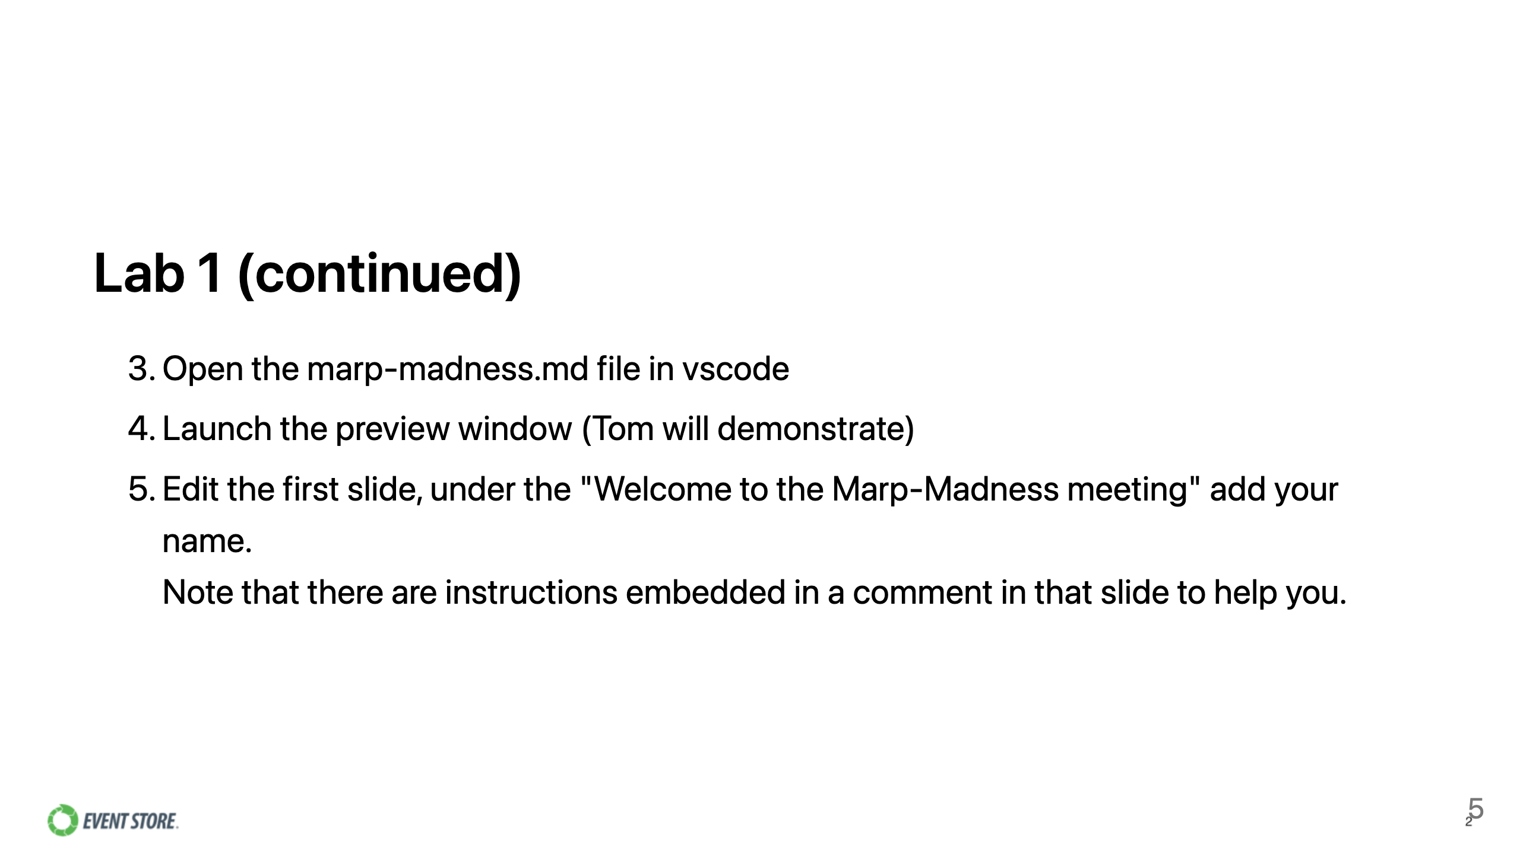

Slide 6

Notes:
The above command directives are embedded as html comments, this is a little strange, but we are basically changing the theme back to original

Slide 7


Slide 8


Slide 9


Slide 10
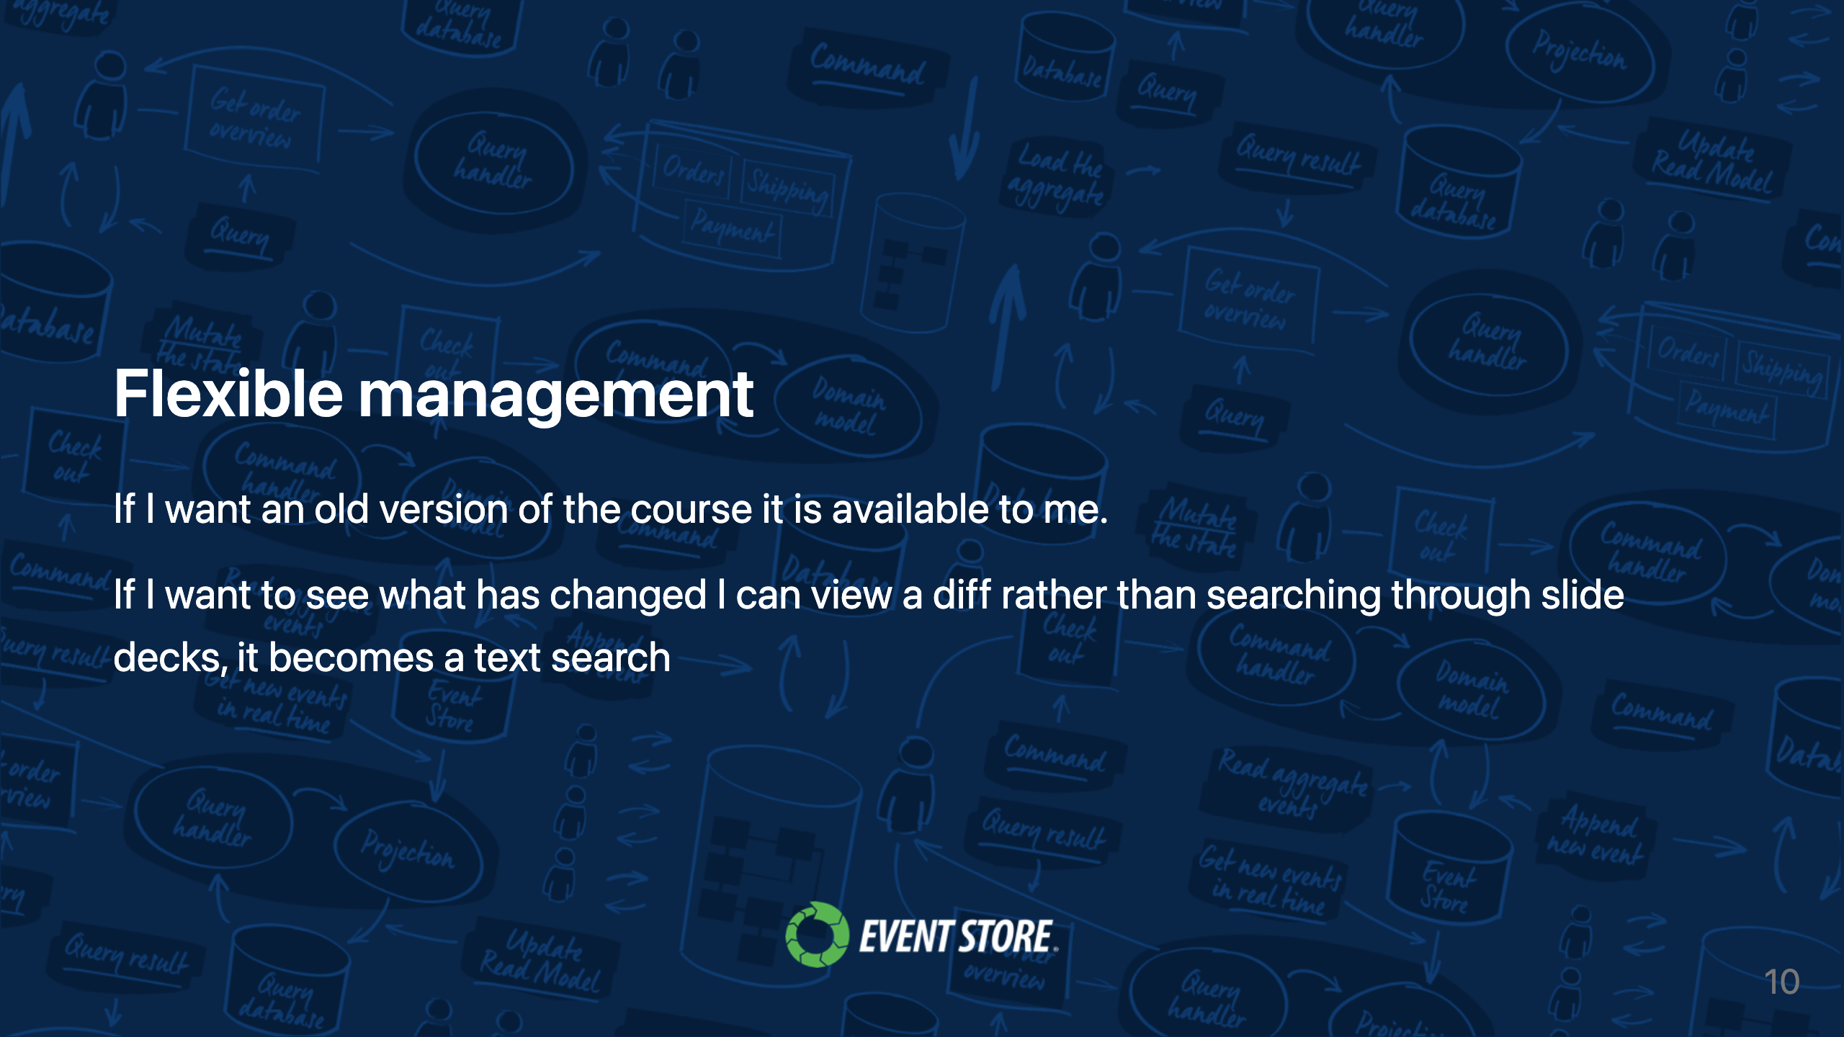

Slide 11
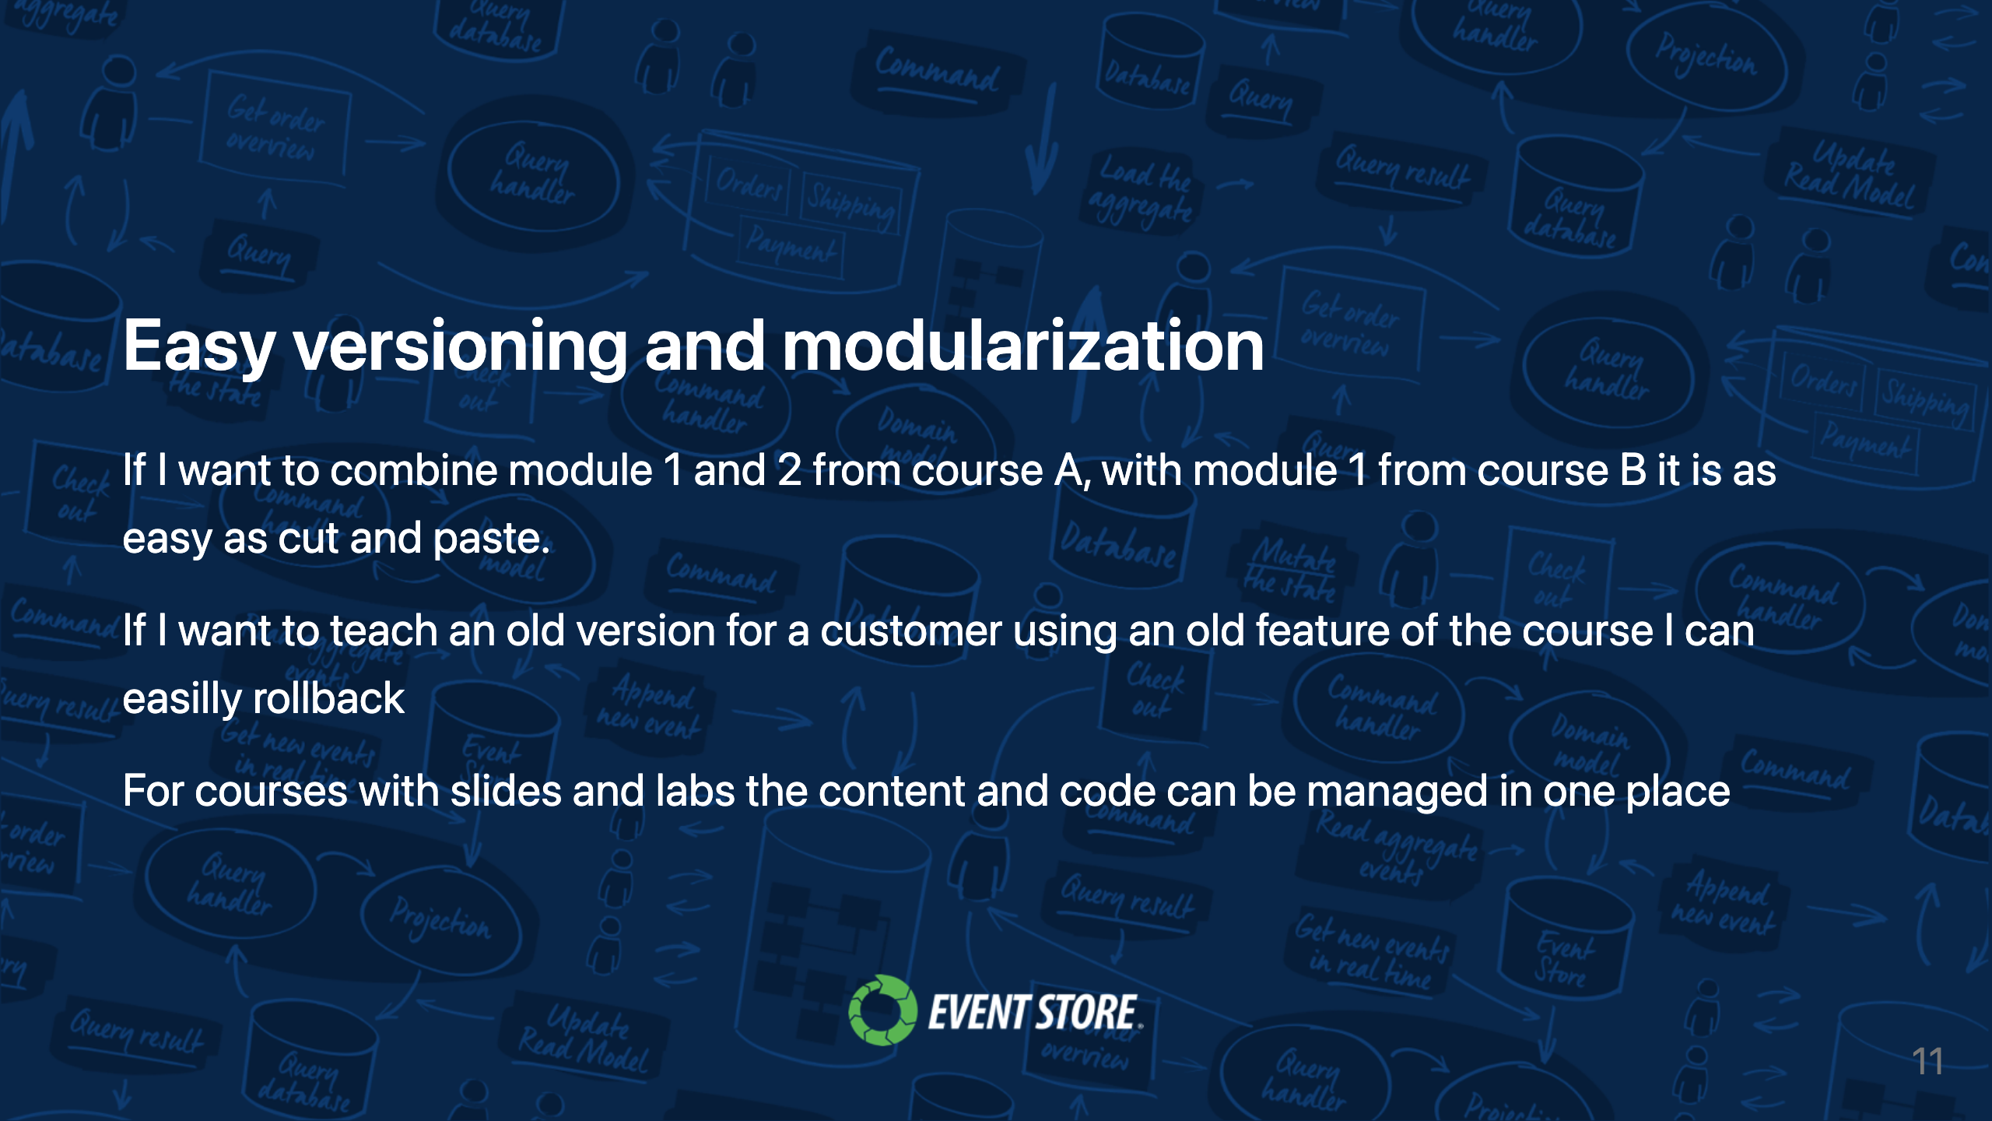

Slide 12


Slide 13


Slide 14


Slide 15
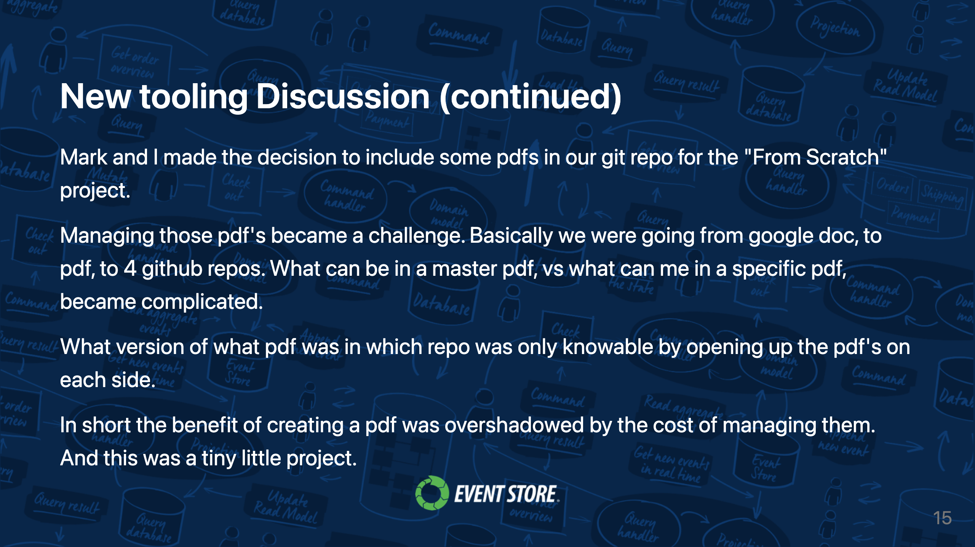

Slide 16
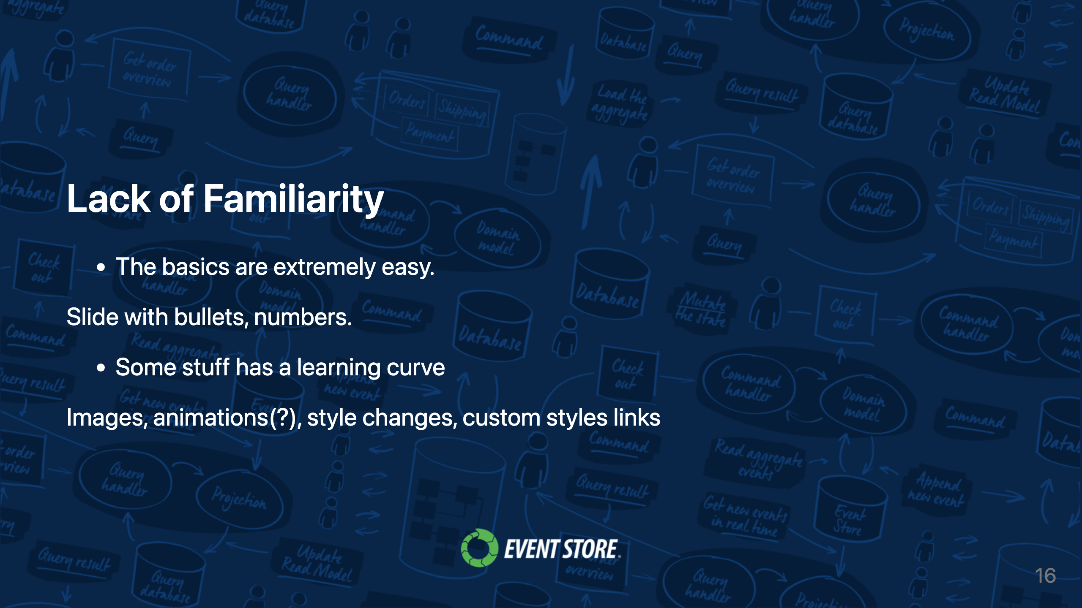

Slide 17


Slide 18
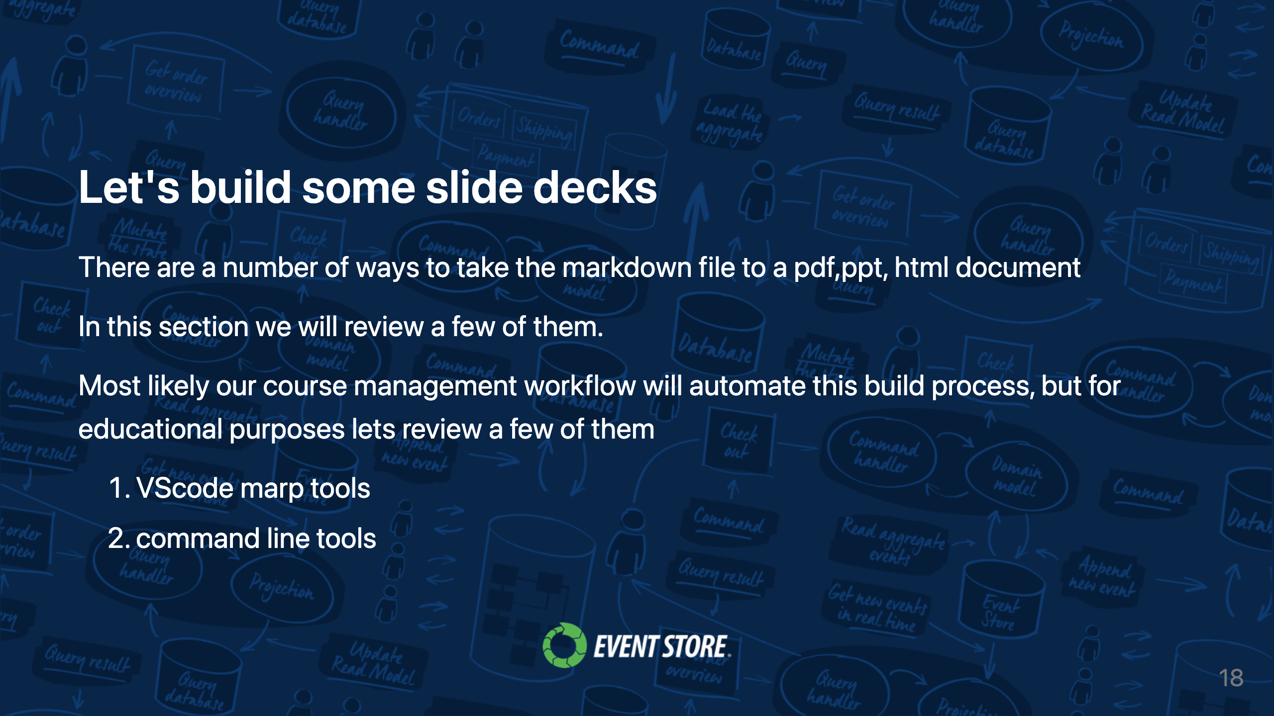

Slide 19


Slide 20
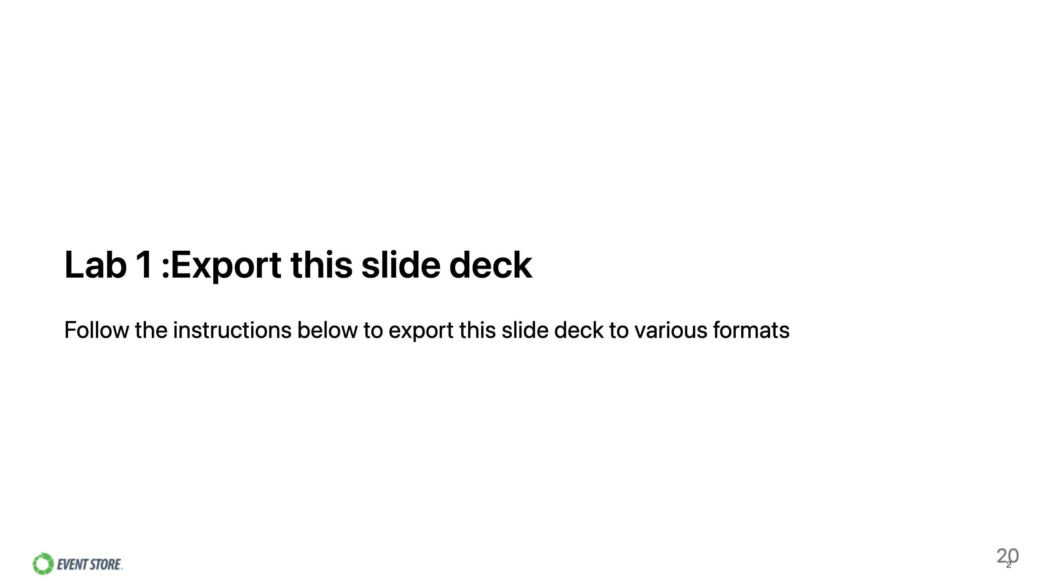

Slide 21
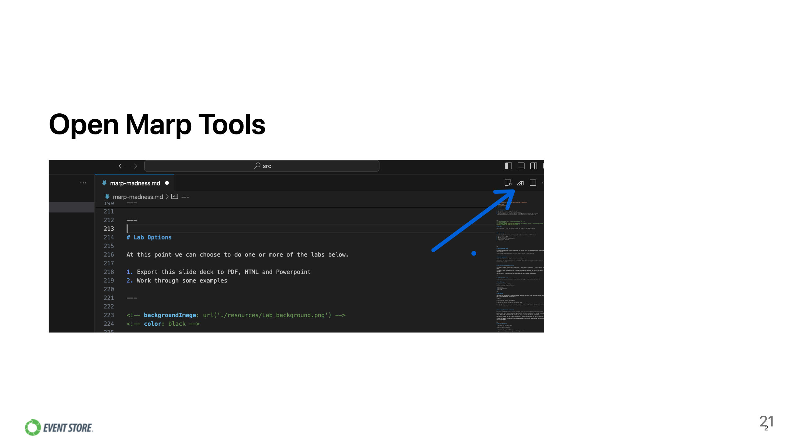

Slide 22
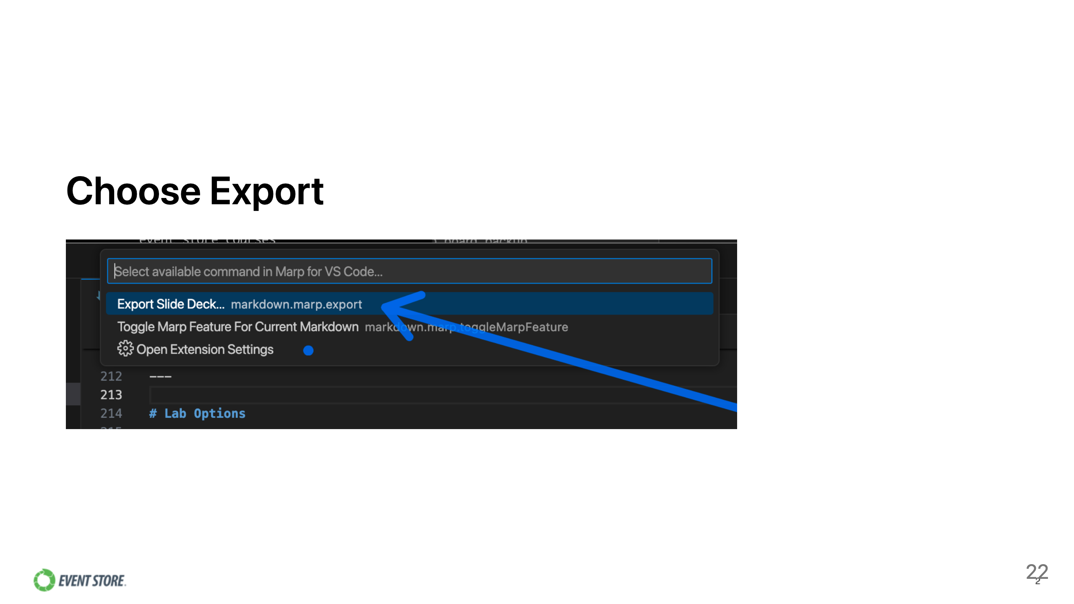

Slide 23
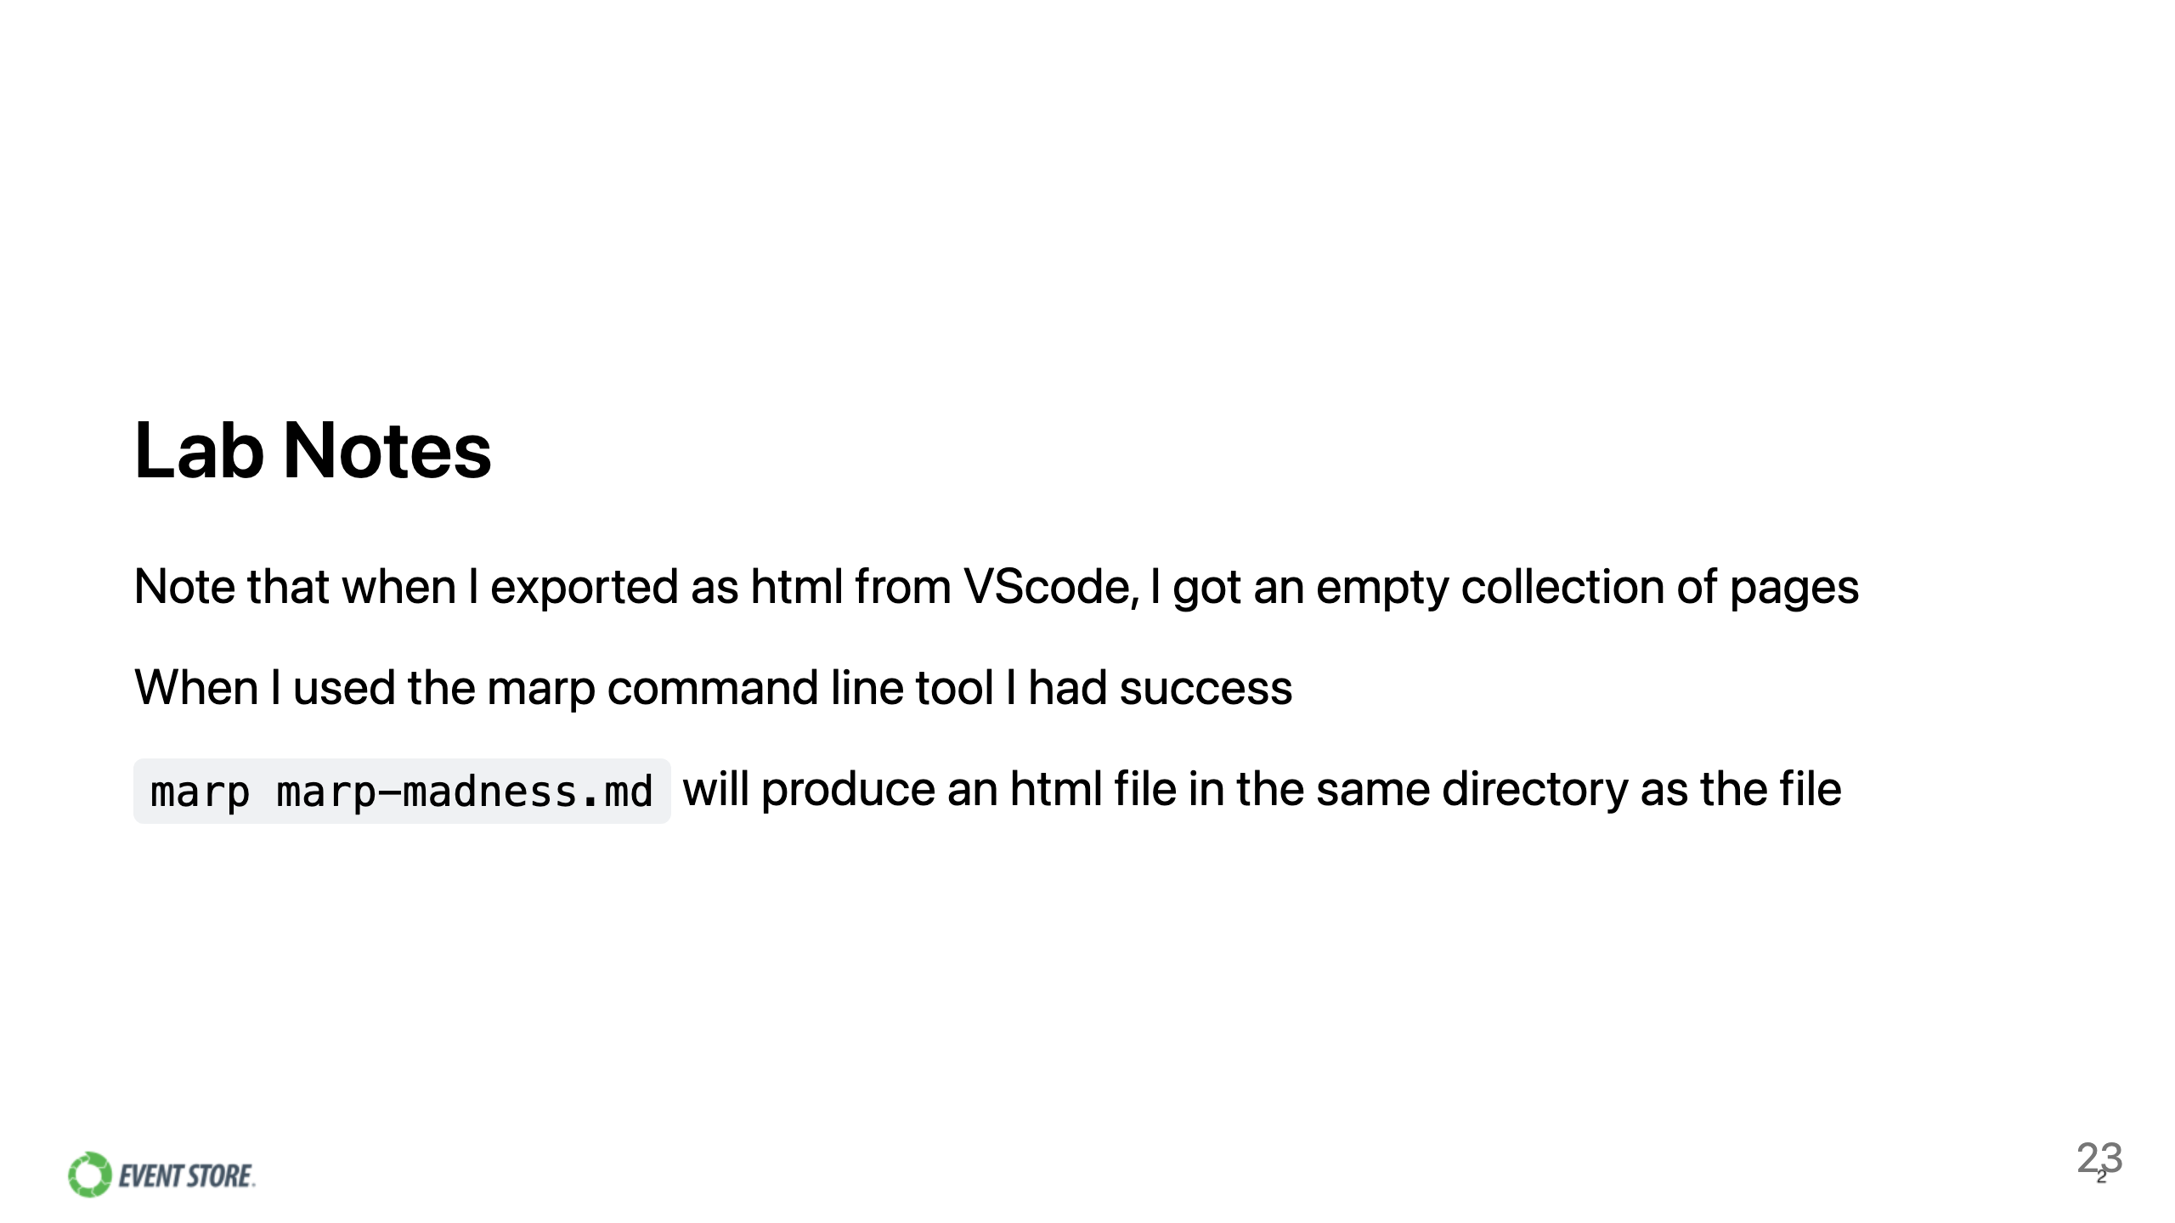

Slide 24
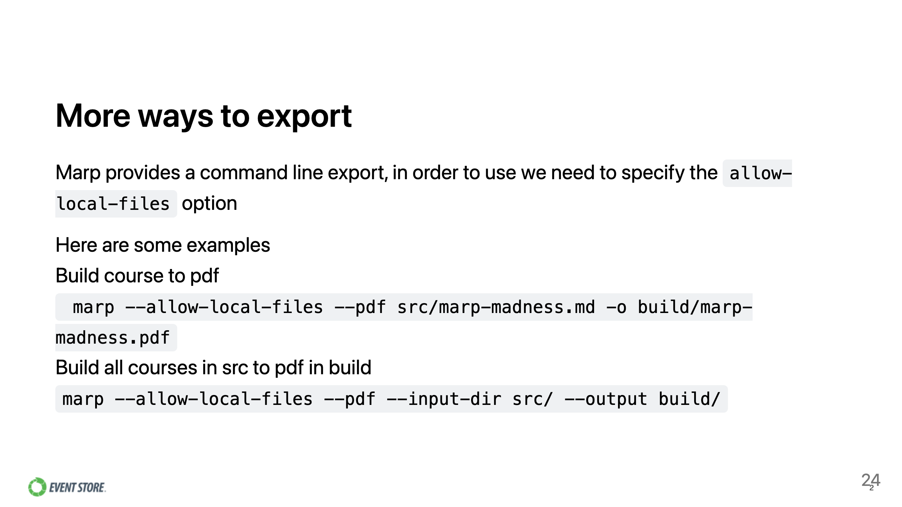

Slide 25
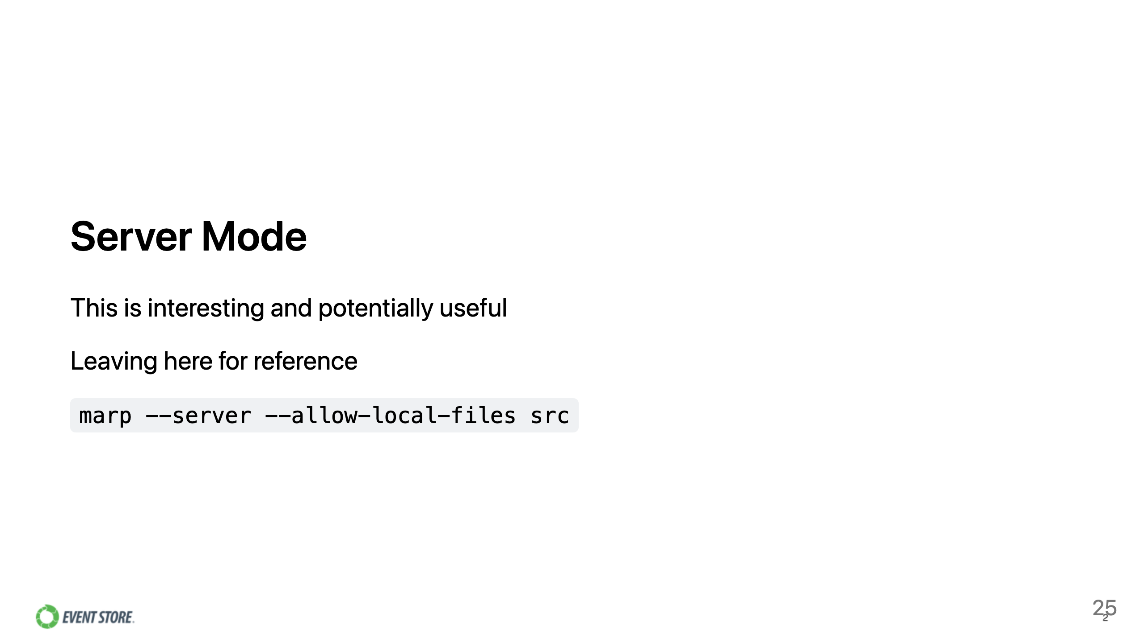

Slide 26


Slide 27
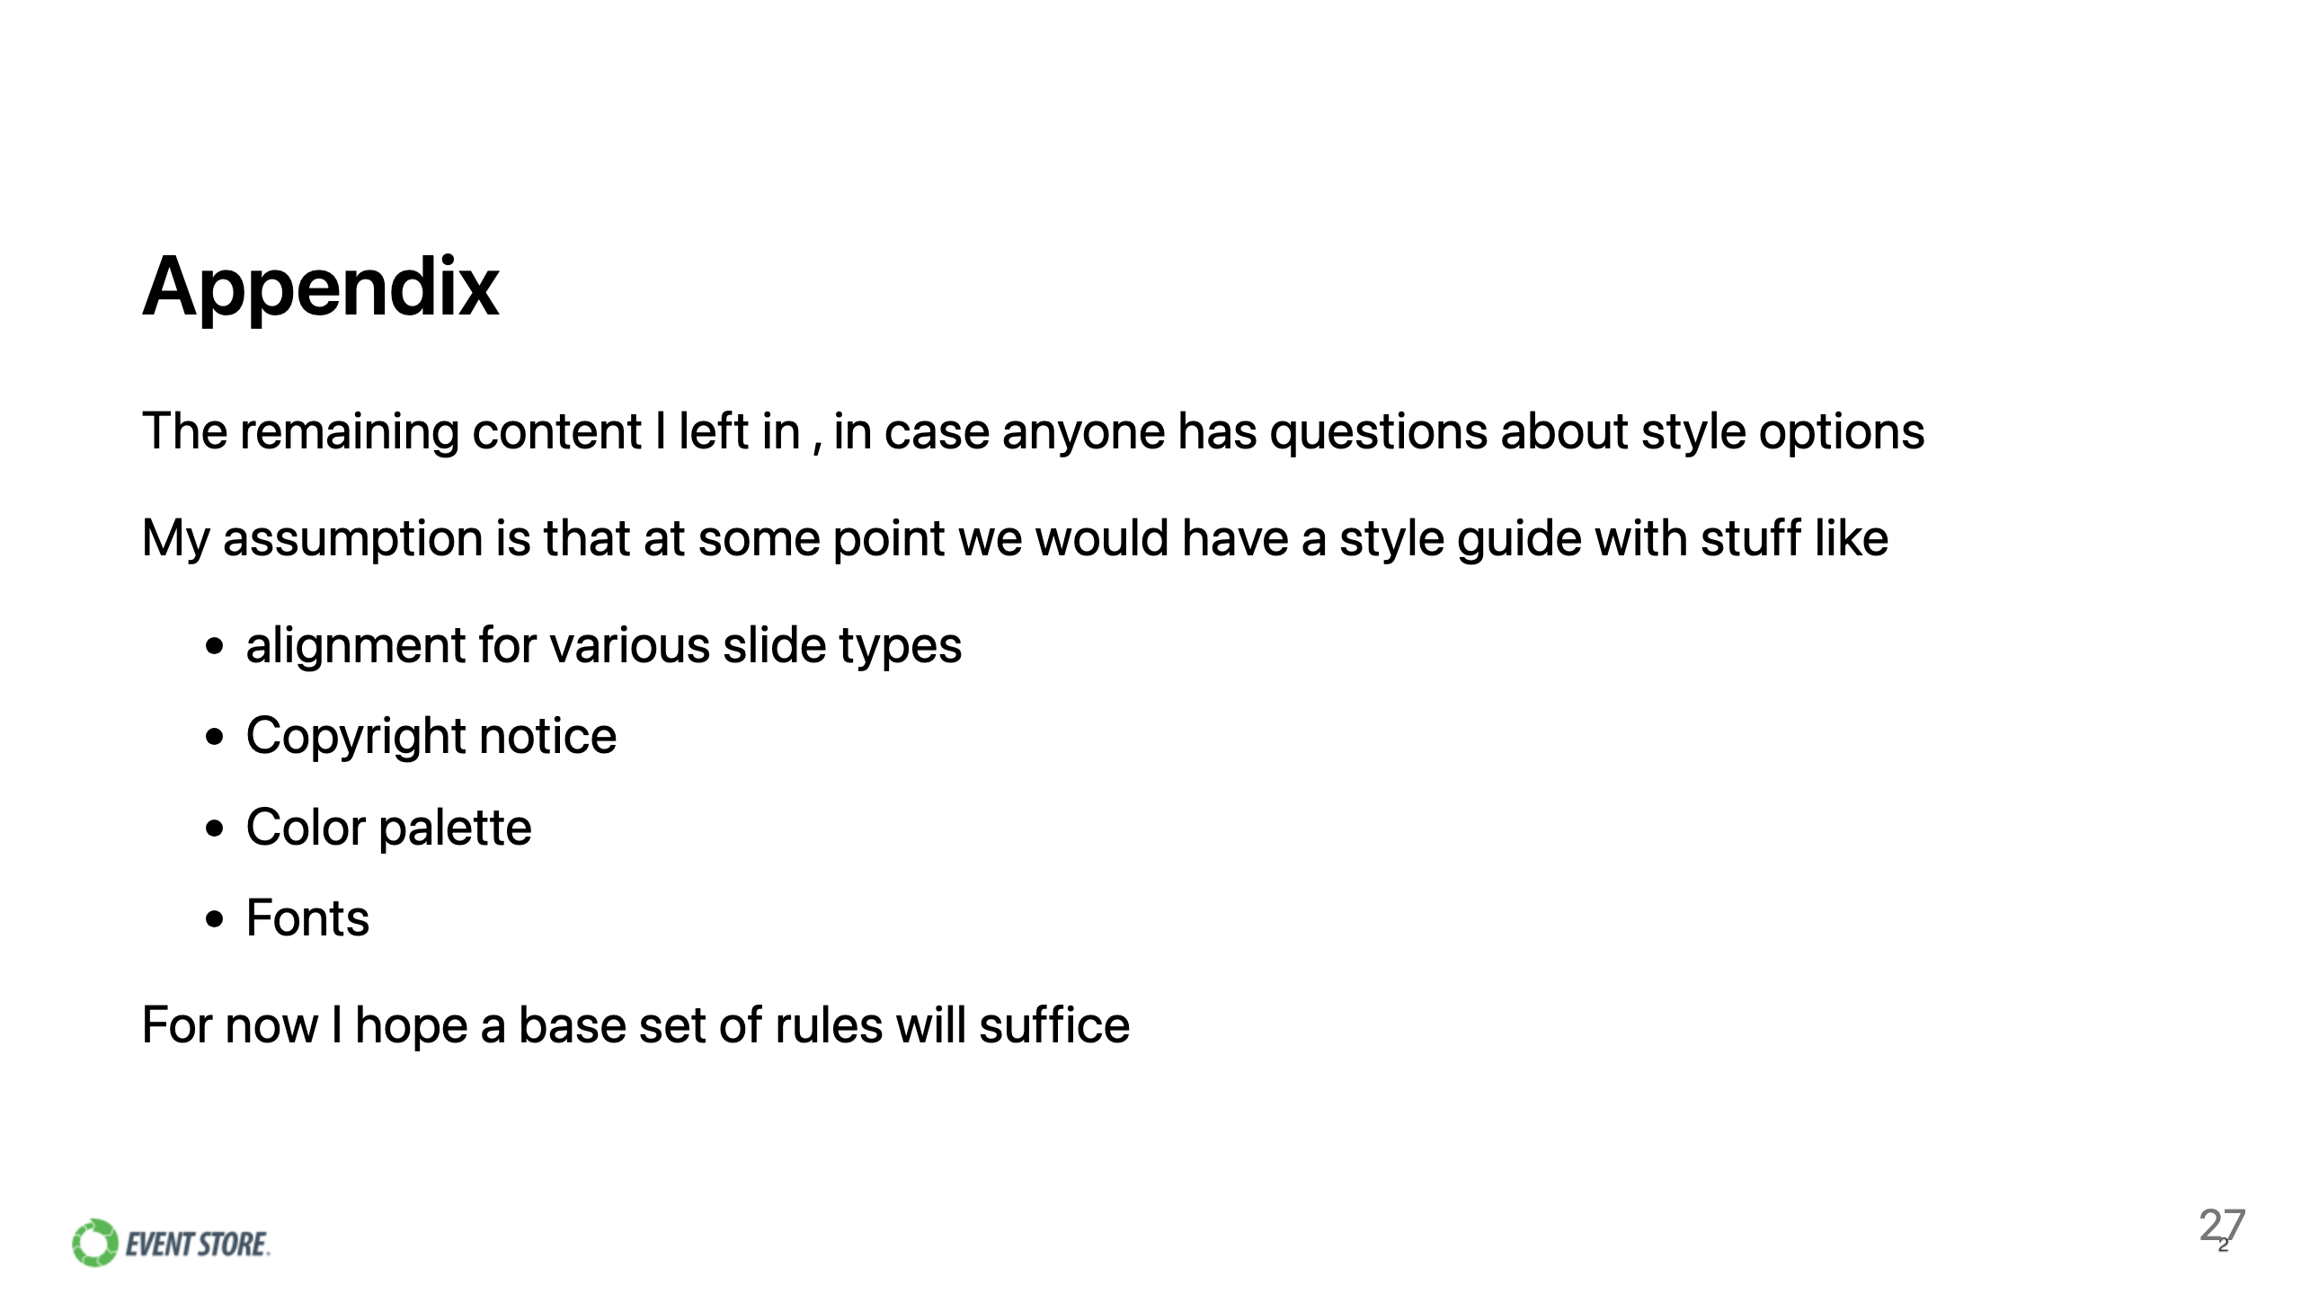

Slide 28
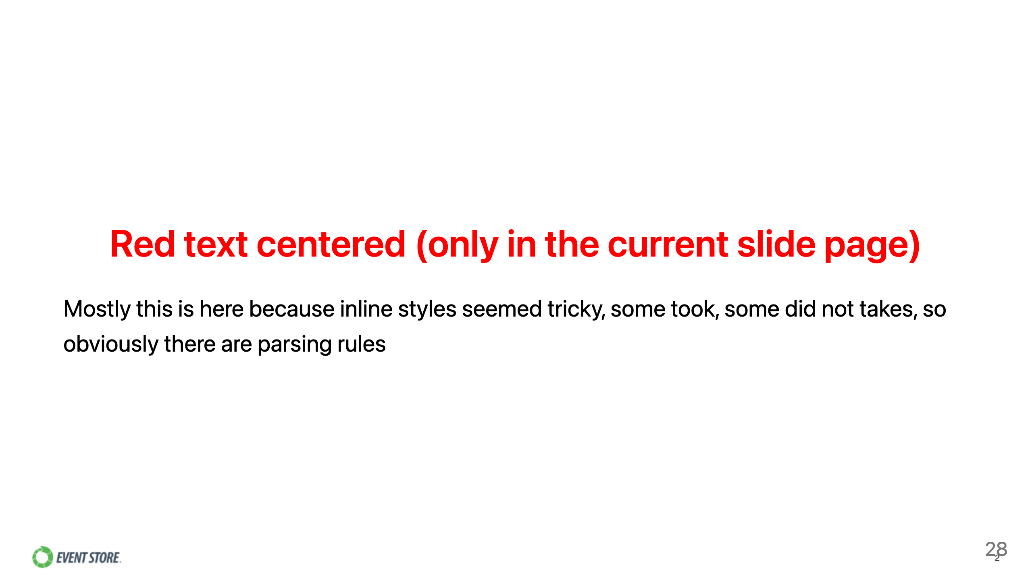
Notes:
Scoped style

Slide 29


Slide 30

Notes:
Scoped style

Slide 31


